Slide 1

.
Educational Chatbot using NLP
Batch no : 20CSEA003
Team members
V.Ganga Bhavani : 20K61A05G9
K.Manasa Lakshmi : 20K61A0571
S.Venkateswara Rao : 20K61A05F3
Guided by :
Dr. A V S Siva Rama Rao
(Assoc. Professor)
.

Slide 2

Introduction about the Problem
Problems of Lack of Interaction and Engagement in Education
Students are struggling with a particular concept or who needed more individualized attention.
Additionally, students who were absent from school or who had difficulty learning in a traditional classroom setting could also fall behind.
Students who needed help with their studies often had to wait for their teacher to be available, which could be a challenge if the teacher was busy with other students.

Slide 3
Existing Solutions
.
Traditional textbooks and lectures
One-on-one tutoring
Discussion groups
Online learning
Self-paced learning
Virtual classrooms
.

Slide 4
Up-in-the-air challenge
Educational Chatbot Using Natural language processing
So ,in a student's life, a chatbot can have a huge impact on the student's life
It is capable of resolving a great deal of academic difficulties, placement preparations, extracurricular activities in the college
Saving a great deal of time by providing answers to student's questions within seconds.
As a result of this chatbot system, departments are able to reduce the amount of work they have to do by providing the required information to students

Slide 5
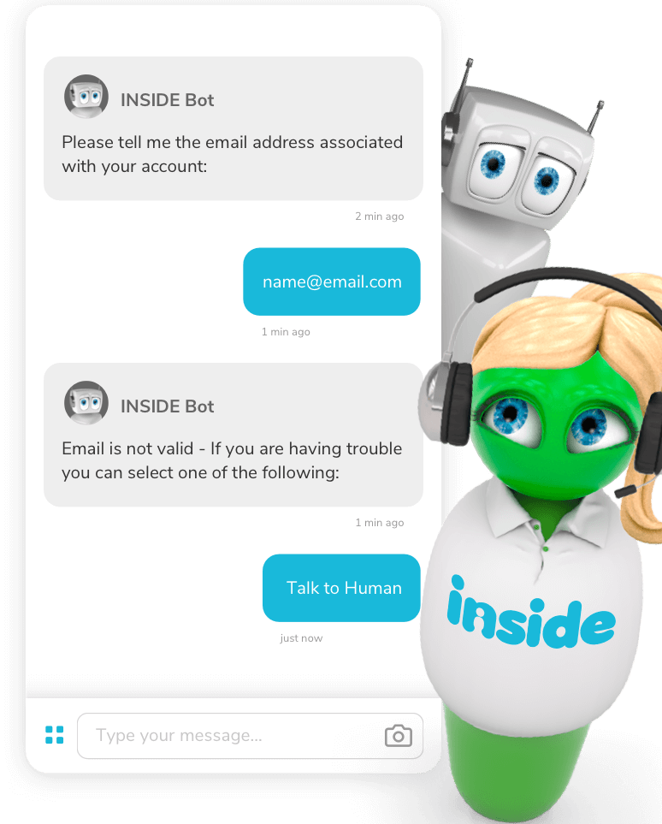
Significance of the problem
Personalized learning experiences
Access to information and resources 24/7
Motivation and encouragement
This application saves time
Chatbots are easy to use and convenient
can handle multiple customer requests at once

Slide 6
Plan of Action
Define the educational goals of the chatbot.
Gather a dataset of text and code that the chatbot can use to learn.
Choose a natural language processing (NLP) model that can understand and respond to human language.
Deploy and manage the chatbot
Get feedback from users.
Keep the chatbot up-to-date

Slide 7
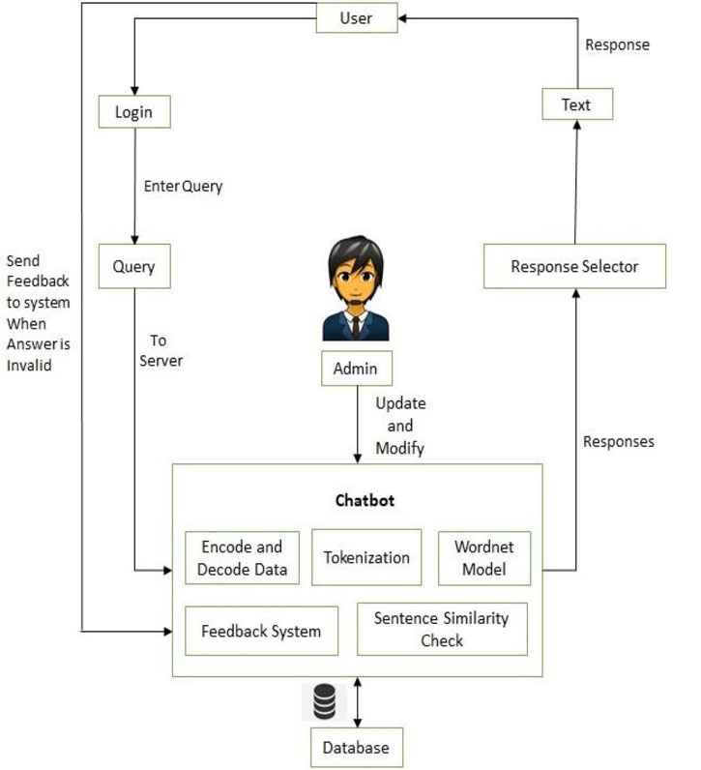
Methods required
Tokenization
Lemmatization
Part-of-speech (POS) tagging
Parsing
Semantic analysis
Speech-to-text
Text-to-speech
Natural language processing

Slide 8

References
The Design of a Conversational Agent for an Intelligent Tutoring System" by Rodrigo A. Santos, et al. (2018)
Chatbots in Education: A Review of Recent Research" by Vahid Zarezadeh, et al. (2019)
Designing an Intelligent Tutoring System with Natural Language Processing" by Xiangen Hu, et al. (2019)
A Review on Intelligent Tutoring Systems and Their Effectiveness in Enhancing Learning" by Swee Eng Wong, et al. (2020)
The Effectiveness of Educational Chatbots: A Systematic Literature Review" by Qinyi Zhang, et al. (2021)

Slide 9
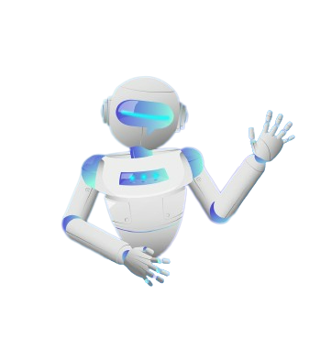
THANK YOU

Slide 10
Applications
Virtual tutoring
Personalized
Motivation and encouragement
Access to information
Assessment and feedback
Administrative tasks

